Slide 1
Sterling E-Commerce Customer Behavior Analysis
3MTT Data Analytics Project
Prepared by: Oyeleye Shina

Slide 2
Project Objective
• Understand customer shopping behavior
• Identify high-demand product categories
• Analyze payment method preferences
• Evaluate location-based performance

Slide 3
Dataset Overview
• E-commerce transaction dataset
• Key fields: Customer ID, Product Category,
Quantity Ordered, Payment Method, Order Date, City
• Each row represents one order

Slide 4
Data Cleaning & Preparation
• Removed duplicates
• Corrected data types
• Created Date table
• Built key DAX measures

Slide 5
Dashboard Overview
• KPI cards for summary metrics
• Date slicer for time filtering
• Bar, column, and line charts
• Interactive analysis

Slide 6
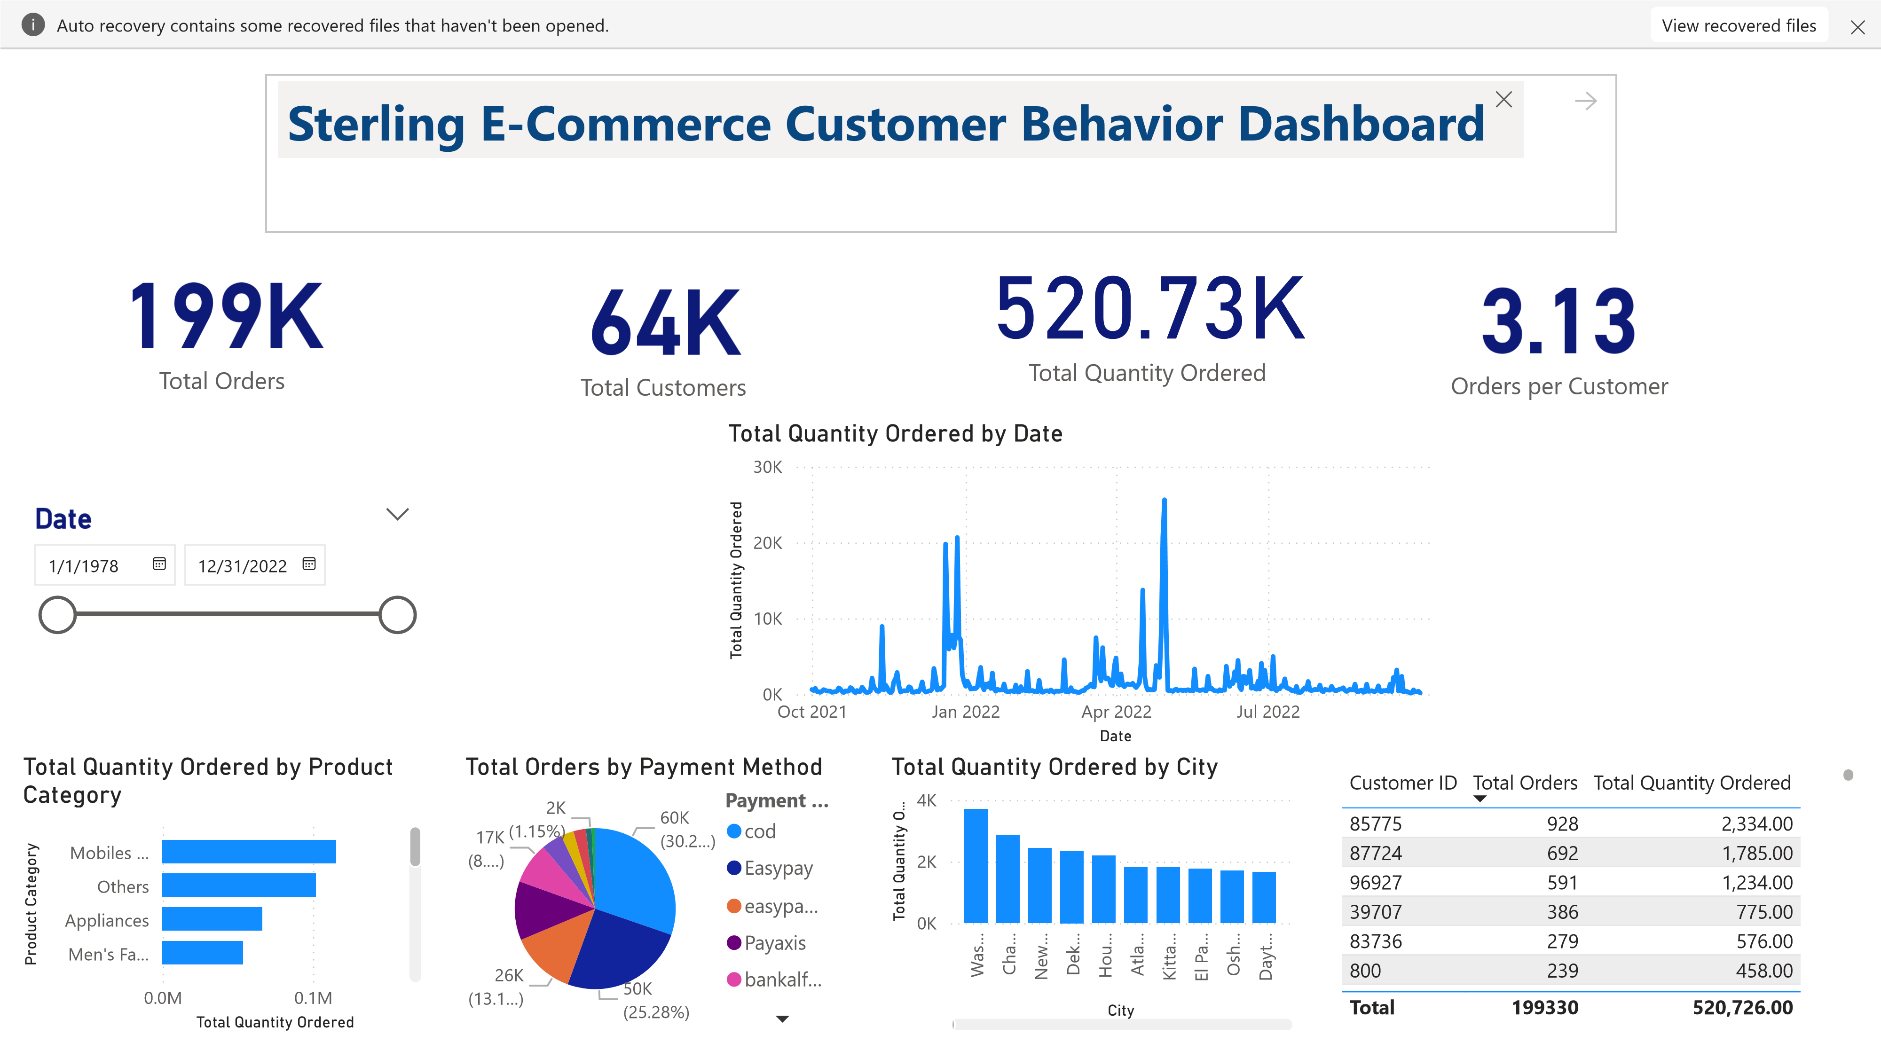
Interactive Power BI Dashboard

Slide 7
Key Insights
• High demand in specific product categories
• Digital payments preferred
• Major cities dominate order volume
• Repeat customer behavior observed

Slide 8
Business Recommendations
• Focus on high-demand categories
• Optimize digital payment methods
• Target high-performing cities
• Introduce customer loyalty programs

Slide 9
Conclusion
• Power BI enabled actionable insights
• Findings support better business decisions
• Customer behavior clearly understood

Slide 10
Thank You

